Slide 1

Ali Hasan -B5IPT0
Simulate stock options using Monte Carlo
17 December, 2024

Slide 2
Hardware Used
I used my laptop mainly for this task and it has:
6 cores, 6 logical processors
Base speed is 2.38 GHz
L1 Cache: 384 KB, L2 Cache: 3.0 MB, L3 Cache: 8.0 MB

Slide 3
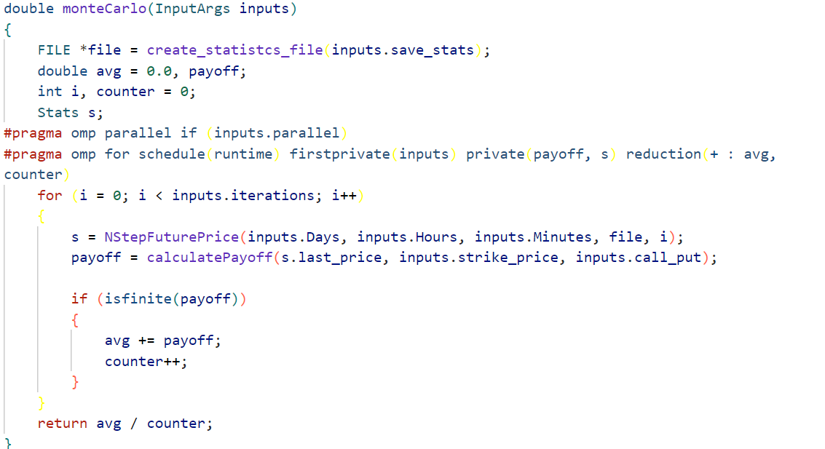
Main Functionality

Slide 4
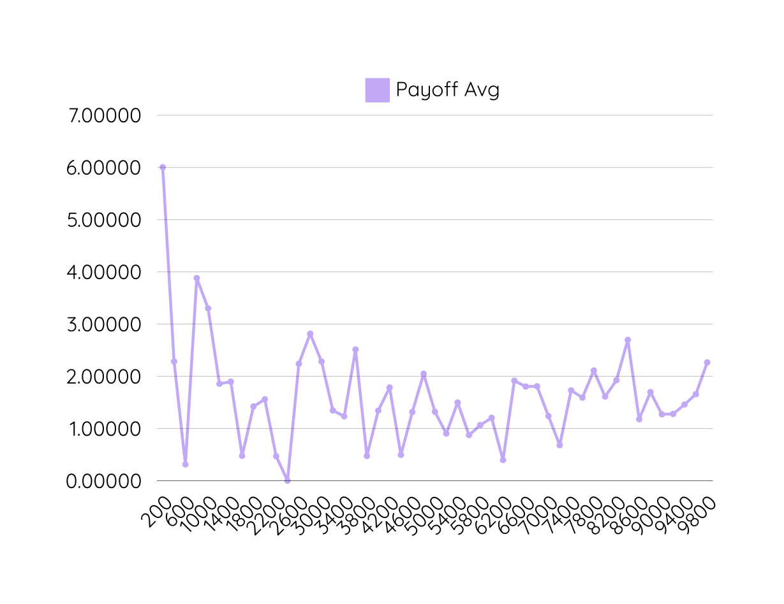
Avg payoff - iterations
Insights:
Avg payoff will 100% fluctuate what ever the number of iteration is , because it is based on random variable generation, which by itself depends on multiple variables and random generation of C program itself.
However, we can see from iteration 1500 , the average fluctuation is less than 3 (3 dollar let’s say) which is a very small number, that’s why I chose 2000 iterations as my base number of iteration

Slide 5
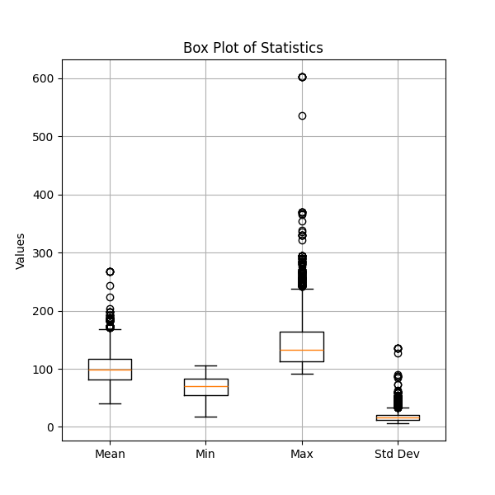
Paths box plot
Fluctuation:
The fluctuation mainly comes for the idea of generating random variables using random variable generation which depend on time and gpu-id which differs a lot each time.
mean avg:
mean of means of payoff for all paths is 100, because, the starting price is 100 , which totally make sense
expected return is set to 0.03 and the expected volatility is set to 0.5
insights
with 3000 iterations, there are multiple outliers, which is normal, because the generated numbers may be very large if the generated random variable is too small, however, the chart show very reasonable results for the simulation.

Slide 6
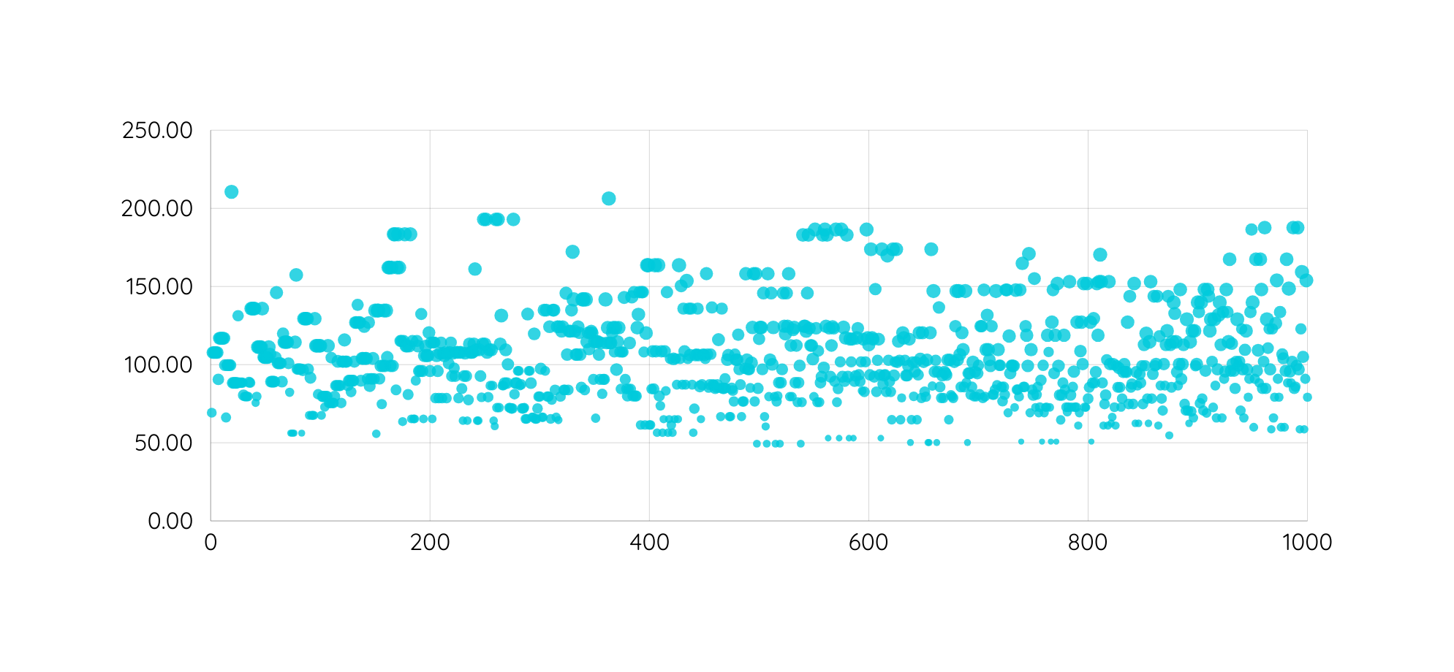
Paths end price
The average of end prices seems to be between 100 and 150 with some outliers, which is totally normal .
iteration end price

Slide 7
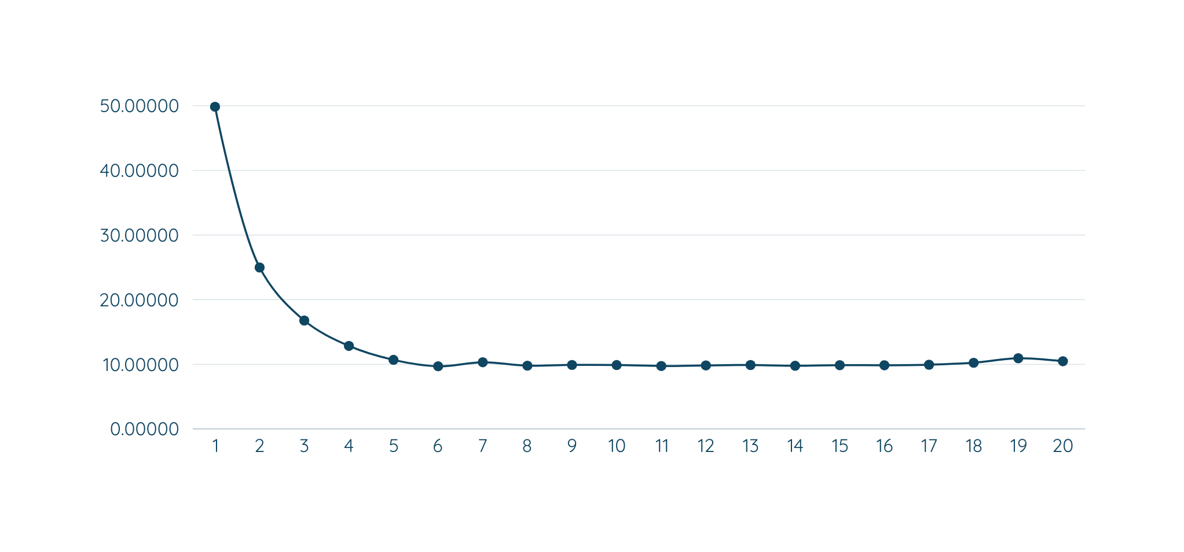
Number of threads
Handling 3000 iterations with different number of threads:
the optimal number of thread for this task is only 6 threads

Slide 8
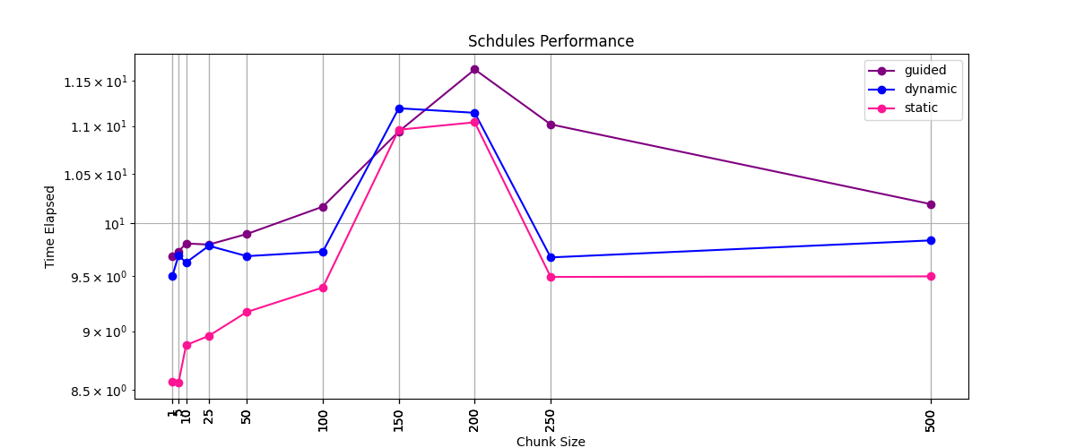
Schedules statistics
Obviously, static schedule is the most powerful schedule in this case (giving that all threads will do the same calculation over and over) and each thread can do 1 to 5 iteration in order to ensure the most optimized workload

Slide 9
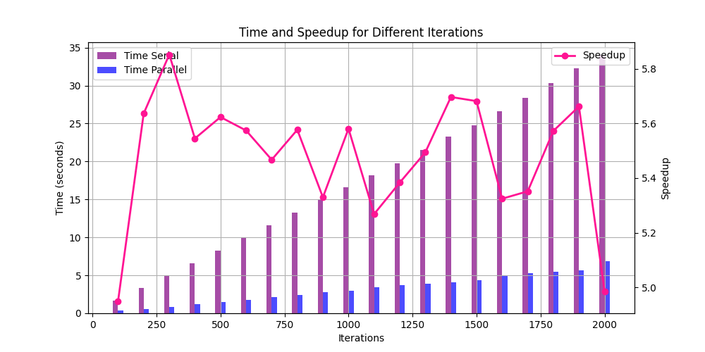
Parallel vs serial / speedup

Slide 10
Thank you

